Slide 1


February 6th, 2024
1:00pm – 4:00pm
Oregon Conservation and Recreation Fund
Advisory Committee Meeting
Virtual Meeting

Slide 2
Agenda Item 1:
Review and Approve Meeting Minutes
(January 10th, 2024)

Slide 3
Draft Motion Templates re: Minutes
I move to approve the January 10th, 2024 meeting minutes with the continued authority to correct spelling, grammar, and punctuation.
I move to approve the January 10th, 2024 meeting minutes with the addition/correction/ deletion of ____ on page ___, line ____, and continued authority to correct spelling, grammar, and punctuation.

Slide 4
Agenda Item 2:
Review and Approve OCRF Urgent Grant Process

Slide 5
Proposed OCRF Urgent Grant Process
Applicant fills out an Urgent Grant pre-application form.
Applicant has a pre-application meeting with ODFW (OCRF Coordinator).
ODFW brings request to OCRF Chairs. If they believe it’s a viable request, Chairs form an Urgent Grant subcommittee (consisting of </= 4 members, 1 is Chair).
Subcommittee reviews the pre-application form and receives a presentation from the applicant.
If approved for next steps by the subcommittee, the applicant will submit a full application.
ODFW staff technical review: 2 technical reviewers will score the project.
Advisory subcommittee reviews: all of subcommittee will score and review the project.
Whole Advisory Committee receives application and pre-application.
Applicant optional presentation at OCRF Advisory Committee public meeting (which can be rescheduled to expedite process).
Approval: ODFW takes the recommended Urgent Grant project to Fish and Wildlife Commission for final approval.
Committee considers and recommends project.
Notes:
Enhanced application questions
Grant receipt history: Have you previously received grants aside from OCRF? What was the $ amount of the largest grant you have received? Who was the granting agency?
How does your project align with the Oregon Conservation Strategy?

Slide 6
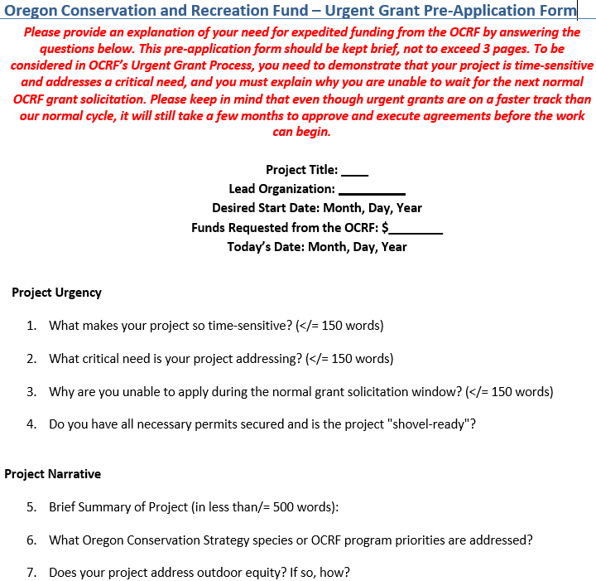

Slide 7
Discussion : OCRF Urgent Grant Process
- What are the Advisory Committee’s thoughts on:
The proposed OCRF Urgent Grant Process?
The urgent grant Pre-Application Questions?

Slide 8
Draft Motion : Urgent Grant Process
I move to approve the OCRF Urgent Grant Process.
I move to approve the OCRF Urgent Grant Process with the addition/deletion of _______.

Slide 9
Agenda Item 3:
OCRF Strategic Plan Review Session

Slide 10
Agenda Item 4 :
Break
(Please be back in 10 min)

Slide 11
Agenda Item 5:
OCRF Communications Plan Proposal

Slide 12
OCRF Strategic Communications Plan
Draft Strategic Plan Priority: | Build broader awareness and understanding of OCRF’s role, impacts, and the value of investments in Oregon’s habitats and wildlife-related recreation.
Actions: Secure resources to support the Advisory Committee’s communication needs. Develop a comprehensive communication plan Develop poignant stories of OCRF successful project and program outcomes, using multiple media, for use and sharing by ODFW and by OCRF partners. Engage grant recipients in supporting OCRF awareness-building efforts.
Today’s recommendation:
Approve expenditure of OCRF donations held by Oregon Wildlife Foundation to support a new contract that:
Develops a strategic communications strategy for OCRF
Develops stories of OCRF project and program outcomes

Slide 13
Agenda Item 6:
OCRF Spring 2024 Grant Solicitation

Slide 14
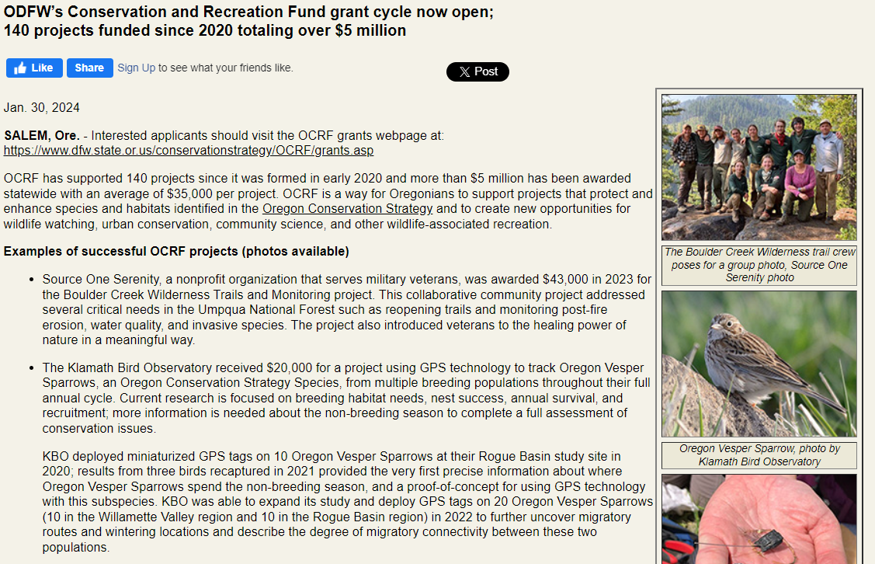
OCRF Grant cycle in ODFW Press Release

Slide 15
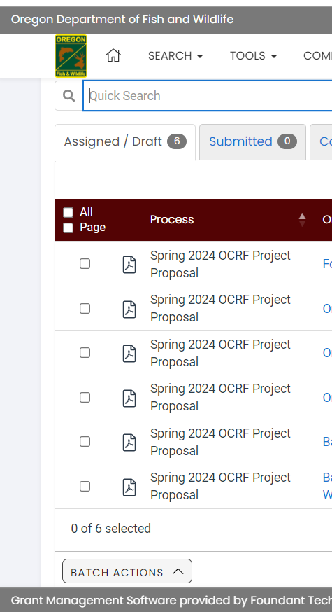
OCRF RFP Update - Spring 2024
Request for Proposals (RFP) – Open January 30th, 2024
Official RFP Guidance made public
Request for Proposals (RFP) – Closes March 26th, 2024
Application must be received by 11:59pm
Technical Review Period – March 27th to April 24th, 2024
OCRF Advisory Committee Review Period – April 25th to May 23rd, 2024
OCRF Advisory Committee Recommendations – June 4th, 2024
ODFW Commission Voting – June 14, 2024
Release of funds following contracting process – August/September 2024

Slide 16
Spring 2024 Applications
Have been live for 1 week
6 draft applications in the new system
Have been receiving ~ 1/day

Slide 17
Agenda Item 7:
Public Comment

Slide 18
Agenda Item 8:
Meeting Wrap-up

